Slide 1
Hardware Optimization for ECG Signal Processing and Arrhythmia Classification Using FPGA-Accelerated Machine Learning and Preprocessing
Team 1 : 23ECB0A01
23ECB0A02
23ECB0A03
Base Paper : Auto MLP: A Framework for the Acceleration of Multi-Layer Perceptron Models on FPGAs for Real-Time Atrial Fibrillation Disease Detection
Link : https://ieeexplore.ieee.org/document/10195220

Slide 2
Index :-
Abstract & Introduction
Novelty
Motivation
Theory
Implementation & Workflow
Code
Results
Simulation output
On-board output
References

Slide 3
Abstract & Introduction
Arrythmia is a common medical condition that is essentially irregularity in the heartbeat. In India alone, more than 10 million cases of Arrythmia are diagnosed each year. However, this diagnosis can be very expensive and also increase the excessive workload on medical staff. Considering the shortage of doctors across the world, this is not ideal.
The increased amount of stress and sedentary lifestyle in the modern era combined with the increase in air pollution increased the likelihood of arrhythmia. Arrhythmia in general can be quite harmless. However, untreated it may be fatal and cause heart failures, heart strokes and cardiac arrests. However, traditional methods are very slow and costly and also power intensive. This leads to complications in the diagnosis process.
In this project, we propose a new methodology to classify Arrythmia in a fast, low power, efficient and accurate manner via a Field Programmable Gate Array (FPGA) board and various machine learning and preprocessing techniques..
ECG signals are utilized to find Arrythmia in heartbeat. (i.e. ECG signals are pre-processed and then classified into various types of Arrythmia). Utilizing FPGA to create application specific circuits helps with keeping the processing costs and power consumption to minimal.

Slide 4
Novelty
Most of the approaches that were implemented in previous works utilize using various types of entropy and statistical features to classify heartbeats. Although this approach may seem fine (Even if you exclude the high computation cost and time required), further analysis can clearly prove that these approaches lose a lot of data during the preprocessing causing the output to be misclassified. (i.e. lots of critical information of the signal is being lost during the preprocessing).
Additionally, previous works focus on classifying a large time sample into normal/abnormal beats whereas the current work proposes a new idea to classify each individual heartbeat to the normal/abnormal category hence by decreasing the chance of missing abnormal heartbeats.
Additionally, the decision tree was optimized for FPGA deployment via pruning making it more hardware efficient and less power consuming.
Additionally, the faster computation speeds allow for a better real-time implementation compared to the bulky computations required in previous works.
The proposed system is also scalable to a larger size implementation easily.

Slide 5
Motivation
Training doctors is a costly process, with estimates suggesting it can take upwards of 250,000$ to 500,000$ (in USA) to fully train a single doctor over several years. At the same time, India faces a shortage of over 90,000 doctors, according to recent healthcare statistics. The lack of medical facilities in rural and underserved areas further compounds this issue, leading to increased patient loads and delayed diagnoses for conditions like Arrhythmia.
This system aims to address these challenges by providing an automated solution for detecting ‘Arrhythmia’ from ECG signals, potentially reducing diagnosis time by a substantial margin and making quality healthcare more accessible. Implementing this project using FPGA-based solutions, in particular, can operate several times faster and power efficient than traditional CPU-based solutions for signal processing and machine learning tasks.
This efficiency leads to significant cost savings, as these systems may operate at a fraction of the expense of traditional diagnostic equipment
By utilizing FPGA technology for parallel processing, this project aims to give new insights in ECG signal processing in an optimized manner. Additionally, this system may also be utilized in various future embedded medical devices for its light-weight and power efficient implementation.

Slide 6
Theory
ADC conversion and Sampling
Data queueing
Preprocessing of signals
Decision tree
ECG Signal Structure

Slide 7
1. ADC conversion and Sampling
By default, ECG signals are analog in nature. However, FPGAs deal with digital data and hence cannot process ECG signals as is. Additionally, the signal should be sampled at a specific frequency. To determine the ideal value of this frequency, we refer to the Nyquist sampling rate of ECG signals.
For generalized medical applications, ECG signals are expected to be sampled at 150-300Hz. For a narrow application such as Arrythmia detection, a sampling frequency of 125Hz helps in reducing in unnecessary noise in the signal.
To convert the analog values of the ECG sensor output to digital values, we use a simple external ADC. Some FPGA boards contain internal ADC modules which can be utilized for the same purpose. However, this was avoided to maintain a generalized approach independent of board.
In our case, an ESP32 was used as the ADC. The ESP32 contains an onboard 12-bit ADC. This 12 Bit data is passed to the FPGA board via its PMOD ports parallelly. (i.e. 12-bits at same time).
The clock divider was made by simply dividing the internal 100MHz of the Nexys DDR4 board with a factor of 80,000 by using a mod 80,000 counter.

Slide 8
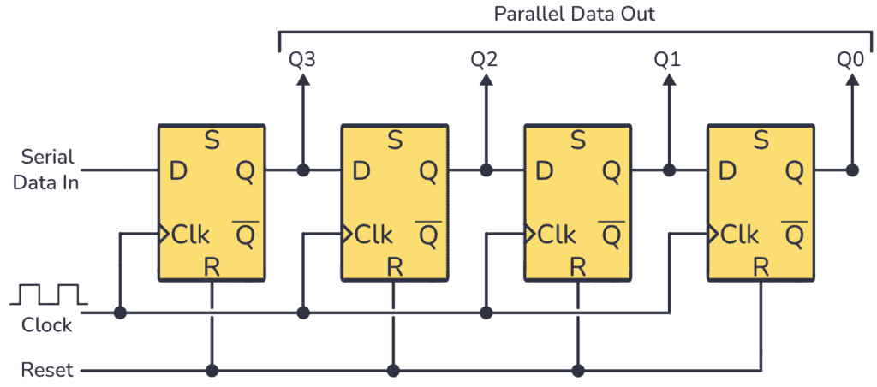
2. Data Queueing
The latest ECG data samples obtained from the external ADC are required to be held on the FPGA in a FIFO manner for further processing.
For this requirement, we create a n-bit shift register using D-Flip flops.
(Note: - Here “N” is the length of the queue and not the ADC resolution).
13 Of these shift-register based queues are created. Each of the queues is used to create a queue of one of the samples.
(First register is used to hold zeroes which indicates the sign of the data point)
Here we utilized a serial in parallel out register for the implementation.
Figure 1[9]

Slide 9
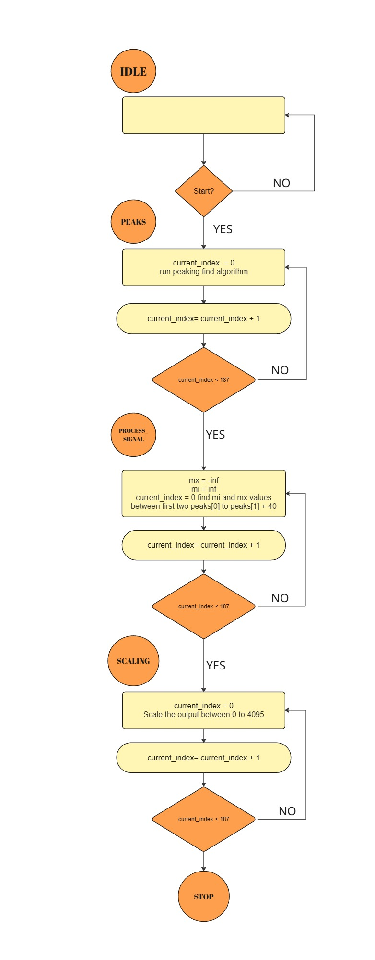
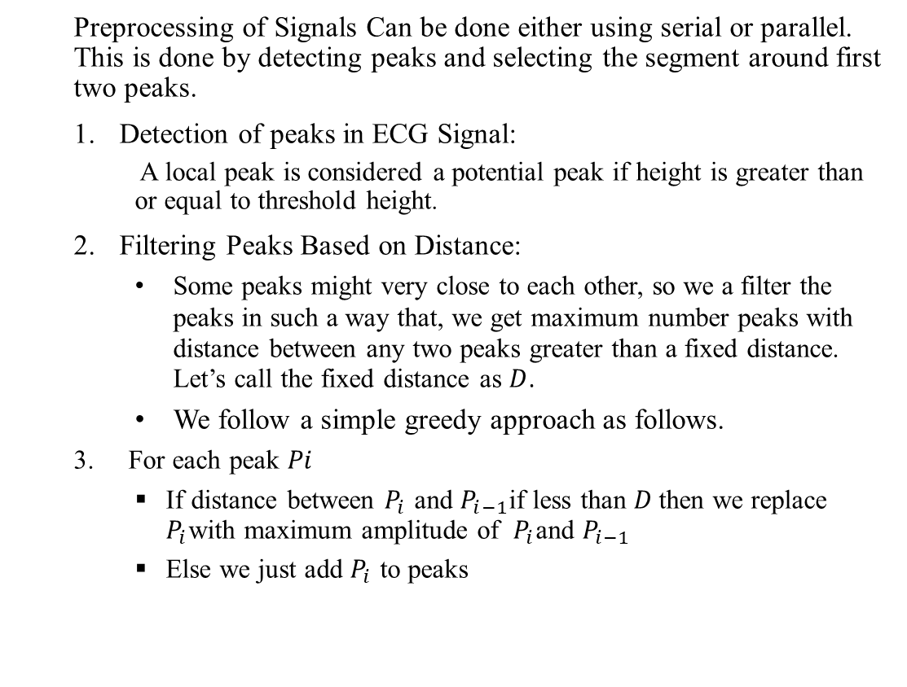
3. Preprocessing of signals
Preprocessing of Signals Can be done either using serial or parallel. This is done by detecting peaks and selecting the segment around first two peaks.
Detection of peaks in ECG Signal:
A local peak is considered a potential peak if height is greater than or equal to threshold height.
Filtering Peaks Based on Distance:
Some peaks might very close to each other, so we a filter the peaks in such a way that, we get maximum number peaks with distance between any two peaks greater than a fixed distance. Let’s call the fixed distance as $D$.
We follow a simple greedy approach as follows.
3. For each peak $Pi$
If distance between $P_{i}$ and $P_{i−1}$if less than $D$then we replace $P_{i}$with maximum amplitude of $P_{i}$and $P_{i−1}$
Else we just add $P_{i}$ to peaks
Figure 2

Slide 10
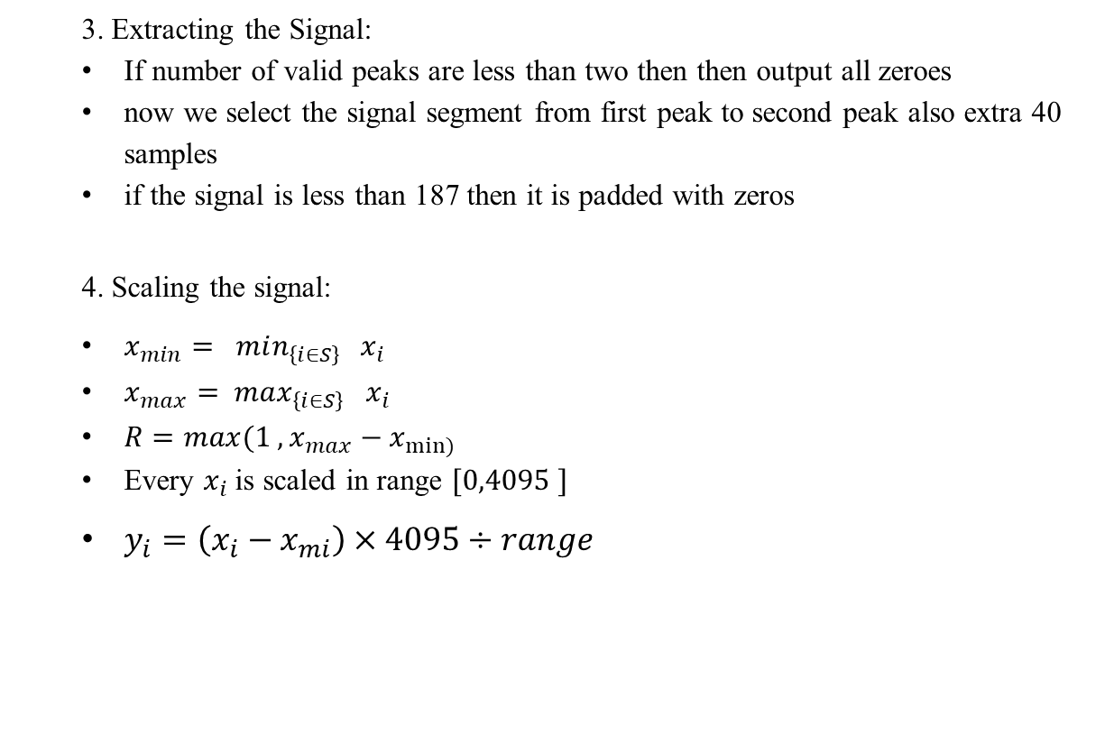
3. Extracting the Signal:
If number of valid peaks are less than two then then output all zeroes
now we select the signal segment from first peak to second peak also extra 40 samples
if the signal is less than 187 then it is padded with zeros
4. Scaling the signal:
$x_{min}= min_{\left\{i∈S\right\} } { x_{i}}_{ }$
$x_{max}= max_{\left\{i∈S\right\}} { x_{i}}_{ }$
$R={max(1 , x}_{max}−x_{min⁡)}$
Every $x_{i}$is scaled in range $[0,4095 ]$
$y_{i}=\left(x_{i}−x_{mi}\right)×4095÷range$
Implementation Type | Processing time | LUT Utilization
Parallel | <100ns (estimate) | 127945
Serial ASM | Around 675 clock cycles (worst case) | 24052

Slide 11
4.Decision Tree
A decision tree is a machine learning model that classifies input data based on various “decision nodes”. It is called a “Tree” due to its shape.
Decision Trees can be used for both classification and regression tasks in general. In this particular study, we utilize them for classification.
The MIT-BIH database is used to the train the decision tree model and later validate its accuracy. To decrease the hardware used and increase the accuracy, we “Prune” the decision tree using Cost Complexity Pruning.
We choose an ideal CCP-Alpha value by testing the decision tree on a part of the Validation data and check the influence of various nodes on the output. Afterwards, we prune the tree by removing the nodes with a low value of CCP-Alpha (i.e. nodes whose existence is not significant to the decision making).
Tree type | Number of nodes | Accuracy
Unpruned Tree | 4711 | 95.39%
Pruned Tree | 1911 | 96.12%
Table 1

Slide 12
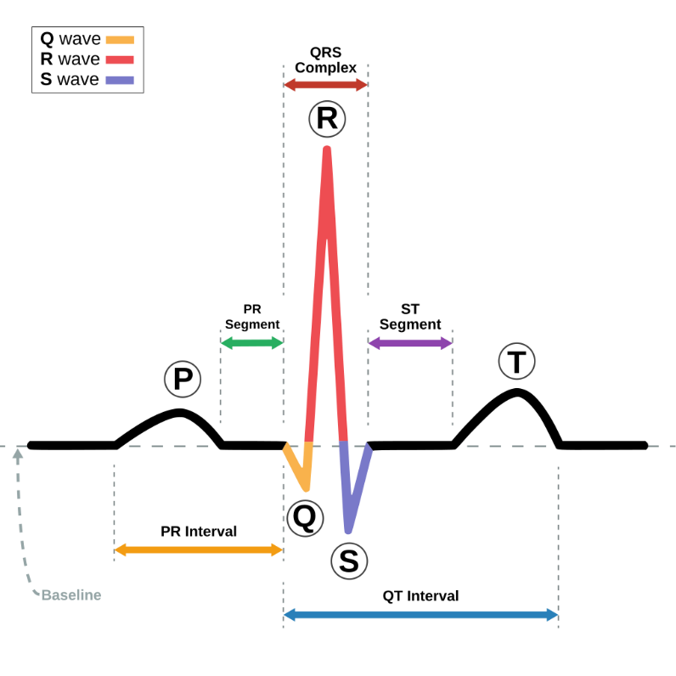
5.ECG Signal Structure
ECG signal gives the rhythmic contraction and expansions of the heart as electrical signals.
These signals are generally obtained by sampling the body at various specific points and then passing them through an amplifier followed by a band pass filter.
The major section of an ECG signal is the QRS complex. Generally, beats segmented by taking two consecutive R-peaks.
We followed a similar procedure in this implementation as explained in the preprocessing section.
Figure 3[8]

Slide 13
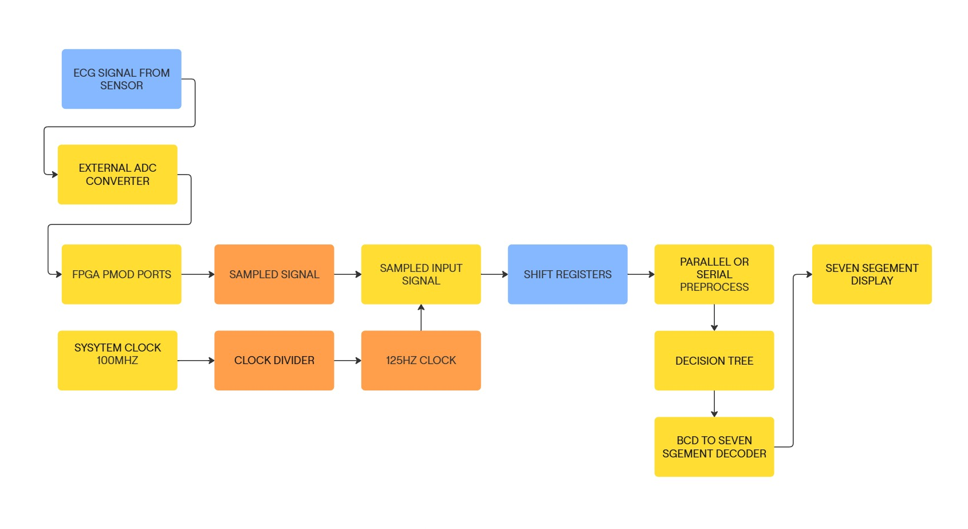
Implementation & Workflow
The system operates on the below pipeline to classify ECG signals into various types of Arrythmia.
1.Data input
ECG signals are taken using a general ECG sensor which consists of a simple amplifier and pass filter. The analog ECG signal is converted into a digital signal using a 12-bit ADC. This 12 Bit signal is passed to the FPGA board via its PMOD ports.
2.Clock Converter
We need to sample the ECG signal at a fixed pre-defined frequency. In this case, we expect a 125Hz signal .By default, the internal clock of FPGAs is very fast. We utilize a clock converter to downscale the clock from very high speed to 125Hz.
3.Data Queue
At each clock edge of the now generated slower clock, we sample the PMOD ports to get an ECG signal sample. We save this data sample into a data queue made using shift registers. In this way we get the required live data.
4.ECG Preprocessing
The now acquired live data is preprocessed using various transformation techniques. Finally, the data is preprocessed in the pre-defined manner and sent to the classifier.
5.Decision Tree based classification
A hardware & time optimized decision tree is utilized to classify the preprocessed signal into the possible heart condition.
6.Output display
After acquiring the classified output, the seven-segment module is utilized to display the classified output on the seven-segment display for easier visualization.
Figure 4

Slide 14
Code
(refer to pdf file/word file for code)
(code too big to fit in PPT)

Slide 15
Results and Conclusion
Classification results
Utilization results
Processing time results

Slide 16
Classification results
Below table shows the accuracy and classification type of various studies.
Though at first sight the proposed work may not seem much different in terms of accuracy, the classification type of the proposed work is multi-class of five classes whereas the previous works focused on binary classification.
Additionally, the amount of preprocessing involved in the previous works is extremely high. This leads to requiring an extreme amount of hardware along with slow processing times.
Reference | Platform | Model | Classification Type | Accuracy
[1] | Xilinx Pynq-Z1 | MLP | Binary | 94.20%
[2] | Intel I7-8550U | AFEntropy | Binary | 94.80%
[3] | Intel I9 | CS-CNN | Binary | 96.25%
Proposed | Artix-7 Nexys DDR4 | Pruned decision Tree | Multi-Class (Five classes) | 96.12%
Table 2

Slide 17
Utilization results
The given table shows the hardware utilization of some previous works.
Here we can see that even after preprocessing the input signal, the hardware utilization of the entire design is much lower than the previous works (Which assumed the signal to be preprocessed externally).
This is a massive gain in the results considering the computation costs of the preprocessing steps that were required for these models especially to calculate the entropy-based features.
The high resource utilization in the previous works can be accredited to the high resource consumption of floating-point multiplications that are required for multi-layer perceptrons,
Reference | Model | Architecture | BRAM | DSP | FF | LUT
[1] | MLP 3 Layer | L1U, L2U | 0 | 21 | 6271 | 15136
[1] | MLP 5 Layer | L1U, L2U | 0 | 22 | 7473 | 24714
[4] | MLP Saric | L1U, L2U | 0 | 21 | 6698 | 18556
[5] | MLP Borghi | L1U, L2U | 0 | 21 | 19454 | 93682
Proposed | Pruned Decision Tree (No preprocessing) | Not applicable | 0 | 0 | 0 | 684
Proposed | Pruned Decision Tree (Serial Preprocessing) | Not applicable | 0 | 0 | 3900 | 24052
Proposed | Prune Decision Tree (Parallel preprocessing) | Not applicable | 0 | 0 | 12978 | 127945
Table 3

Slide 18
Processing Time Results
Table below shows the evaluation time for various designs in previous works.
Here we can see that our proposed work shows a massive improvement in the calculation time. (Note that the preprocessing used in [1] is extremely computationally expensive) On the Nexys 4DDR, the serial preprocessing pruned decision tree can be expected to take around 6.75 micro seconds.
This time can be reduced by applying various approaches to decrease the preprocessing time and can be expected to be optimized to around 1-2 micro seconds (Worst case).
It is very difficult to find the exact time it takes for the output in the parallel preprocessing case but we can estimate it to less than 100ns based on the design.
This can still be considered extremely fast and real time considering that the sampling rate of the input signal is 125Hz (Around 10 ms).
Reference | Classification model | Other factors | Evaluation time
[1] | MLP 3 Layers | No preprocessing | 200ns
[1] | MLP 5 Layers | No preprocessing | 260ns
Proposed | Pruned Decision Tree | No preprocessing | 10.675ns
Proposed | Pruned Decision Tree | Parallel preprocessing | <100ns (estimate)
Proposed | Pruned Decision Tree | Serial preprocessing | Around 675 clock cycles (worst case)
Table 4

Slide 19
Simulation Output
Parallel preprocessing output
General TCL console output of pre-processed signal

Slide 20
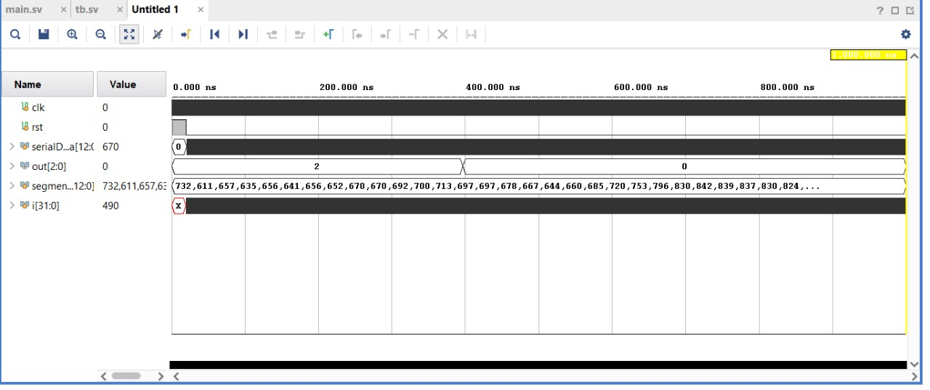
Parallel preprocessing output
Data is passed clock by clock to the queue using the serial Data 13-bit port (First bit is always 0 just to denote sign).
While the input is yet to be filled, the output is unstable (Output comes out as 2 which refers to Ventricular ectopic beat). This is just a consequence of the preprocess output being all 0s and can be ignored.
After the input is filled with enough number of samples, the output becomes the actual prediction (Which is 0 in this case which refers to normal heartbeat).
Although not shown here, the output of serial preprocessing will be identical except for a small time period during which the output will be unstable (During preprocessing).
Figure 5

Slide 21
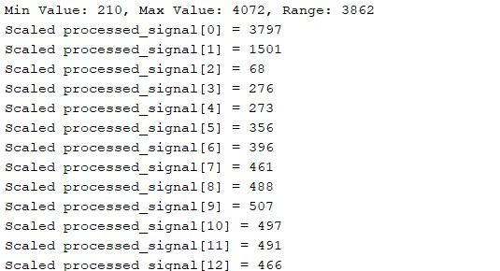
Sample TCL console output of pre-processed signal
Given image shows a sample of the output of the preprocessing module after finishing a preprocessing iteration on a queue. (Same output will be obtained for both parallel and serial preprocessing).
We can see that the preprocessing module considers the minimum value, maximum value and the range to properly normalize the considered segment from 0 to 4095 (Both inclusive).
Figure 6

Slide 22
On-Board output
Output when signals are saved onto FPGA and are directly passed
Output when ESP32 is used to pass ECG signals

Slide 23
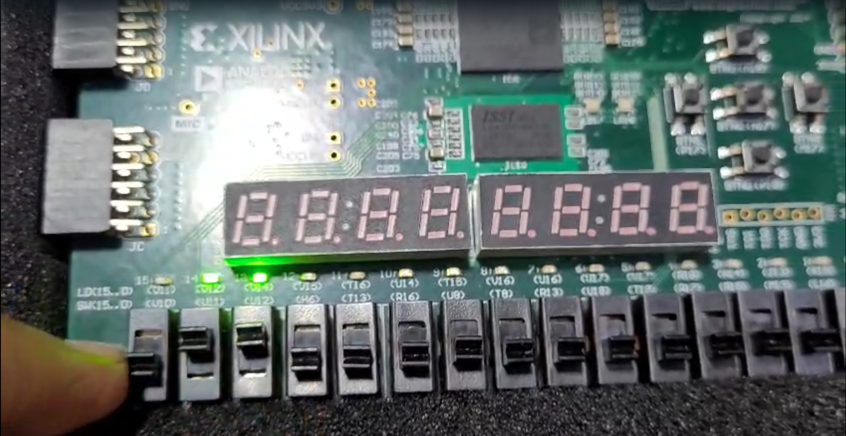
Output when signals are saved onto FPGA and are directly passed
Segments of various ECG sections was saved onto the FPGA before hand as registers and the signals are multiplexed between different types of heart beat segments using switches.
The output class is displayed on the LEDs as shown. The output matched the expectations.
Figure 7

Slide 24
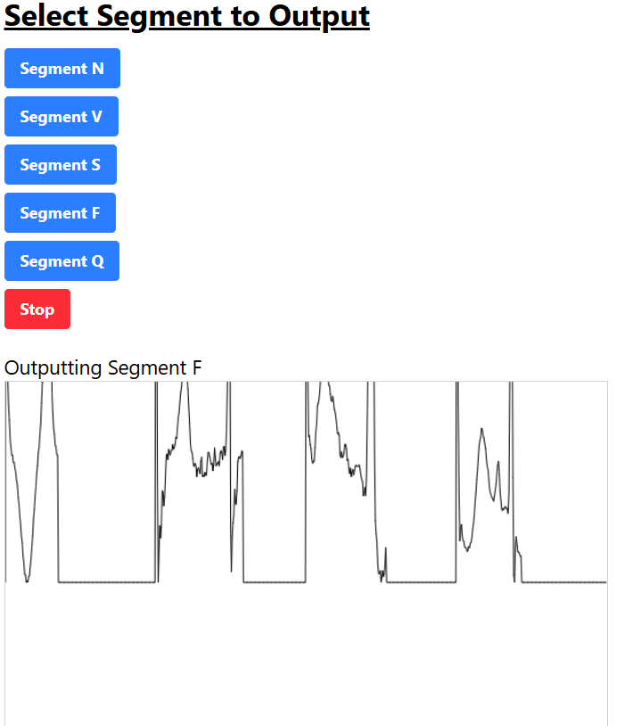

Output when ESP32 is used to pass ECG signals
ESP32 is used to pass segments into the FPGA via its PMOD ports. A simple webserver was setup using the ESP32 to output different outputs.
As both the FPGA and ESP32 are working at 3.3V, we can freely pass data between the devices using a common ground as refe
Above photo shows the output of the FPGA with data being passed from the ESP32. Due to timing issues, the output was not stable and we were not able to capture it properly. Further improvements can be made using better timing-based algorithms to get better output. (Such as holding data, using start, busy signals etc etc).

Slide 25
References
[1] C. Chen, B. da Silva, C. Yang, C. Ma, J. Li and C. Liu, "AutoMLP: A Framework for the Acceleration of Multi-Layer Perceptron Models on FPGAs for Real-Time Atrial Fibrillation Disease Detection," in IEEE Transactions on Biomedical Circuits and Systems, vol. 17, no. 6
[2] L. Zhao, C. Liu, S. Wei, Q. Shen, F. Zhou and J. Li, "A new entropy-based atrial fibrillation detection method for scanning wearable ECG recordings", Entropy, vol. 20, no. 12, 2018.
[3] H. Zhang, Z. Dong, J. Gao, P. Lu and Z. Wang, "Automatic screening method for atrial fibrillation based on lossy compression of the electrocardiogram signal", Physiol. Meas., vol. 41, no. 7, 2020
[4] P. H. Borghi, R. C. Borges and J. P. Teixeira, "Atrial fibrillation classification based on MLP networks by extracting Jitter and Shimmer parameters", Procedia Comput. Sci., vol. 181, pp. 931-939, 2021.
[5] R. Sarić, D. Jokić, N. Beganović, L. G. Pokvić and A. Badnjević, "FPGAbased real-time epileptic seizure classification using artificial neural network", Biomed. Signal Process. Control, vol. 62, 2020.
[6] https://www.build-electronic-circuits.com/shift-register/
[7] https://en.wikipedia.org/wiki/File:SinusRhythmLabels.svg
[8] https://en.wikipedia.org/wiki/Electrocardiography
[9] https://encrypted-tbn0.gstatic.com/images?q=tbn:ANd9GcQVHf-ujRLqgrITIcRYYynyiaSZGqHiF8S7Gg&s

